Slide 1
YouTube Data Harvesting and Warehousing using SQL and Streamlit
Name : VIVEKARAJAN S
Batch: MDTM017
Contact: 8667422017
Credits: GUVI
Presented by,
Vivekarajan S

Slide 2
Introduction
YouTube, the online video-sharing platform, has revolutionized the way we consume and interact with media. Launched in 2005, it has grown into a global phenomenon, serving as a hub for entertainment, education and community engagement with its vast user base and diverse content library. YouTube has become a powerful tool for individuals, creators, and businesses to share their stories, express themselves, and connect with audiences worldwide.

Slide 3
PROBLEM STATEMENT
The problem statement is to create a Streamlit application that allows users to access and analyze data from multiple YouTube channels. The application should have the following features:
Ability to input a YouTube channel ID and retrieve all the relevant data (Channel name, subscribers, total video count, playlist ID, video ID, likes, dislikes, comments of each video) using Google API.
Ability to collect data for up to 10 different YouTube channels and store them in the data lake by clicking a button.
Option to store the data in a MYSQL or PostgreSQL.
Ability to search and retrieve data from the SQL database using different search options, including joining tables to get channel details.

Slide 4
OBJECTIVE
Here, I completed a streamlit user interface project for YouTube data gathering and warehousing. This project pulls data from YouTube and saves it in a MySQL database using a YouTube API key. then it retrieves information from MySQL and produces a reply for every one of the ten sample queries. Lastly, a chart of analysis for the sample problem that I chose is shown.

Slide 5
API key
Initially signup and create a project. so we get a API key from google console developer site.
The procedure well defined in video which includes in this part of project.
That must be enabled and then it can be used in the python coding.

Slide 6
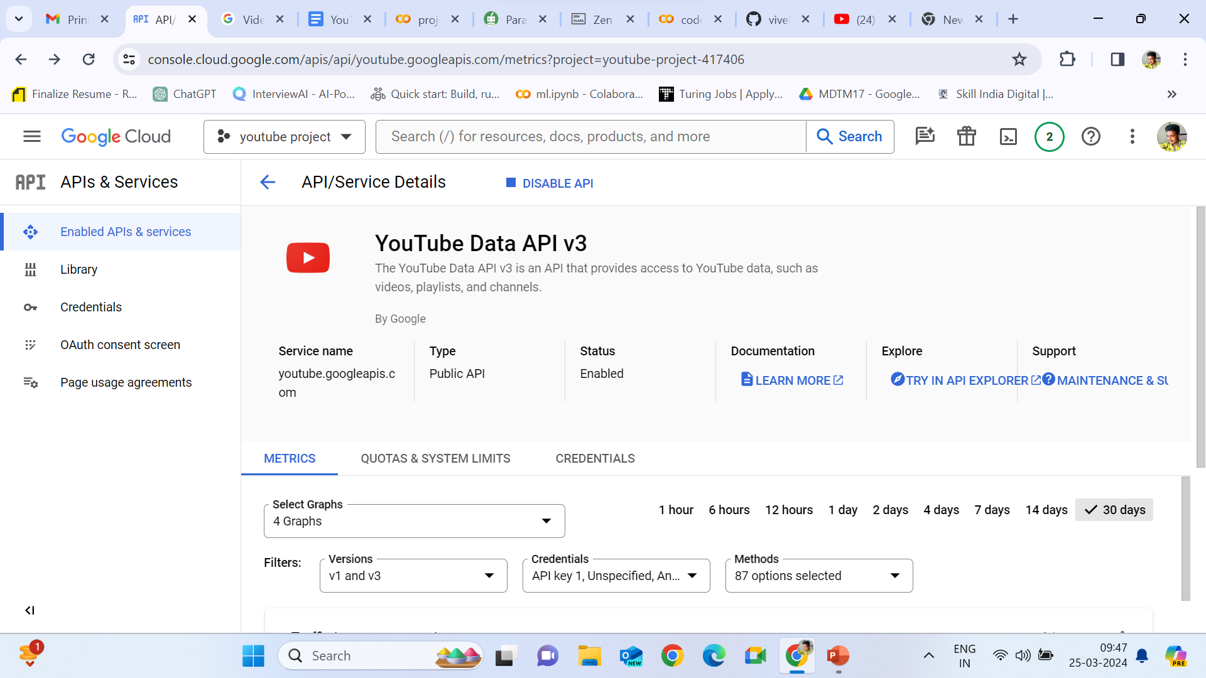
ScreenShot for API enabling

Slide 7
REQUIRED TOOLS
Visual Studio.
Python 3.12.0 or higher.
MySQL WORKBENCH.
Youtube API key.
GOOGLE CHROME (any other browsers)

Slide 8
Requirement Libraries to Install
pip install google-api-python-client,pprint, mysql-connector-python, pymysql, pandas, numpy, plotly-express, streamlit, DateTime, Regular Expression.
( pip install google-api-python-client / mysql-connector-python / pandas / numpy / plotly-express / streamlit / DateTime / regular Expression )
All these are done with command prompt.

Slide 9
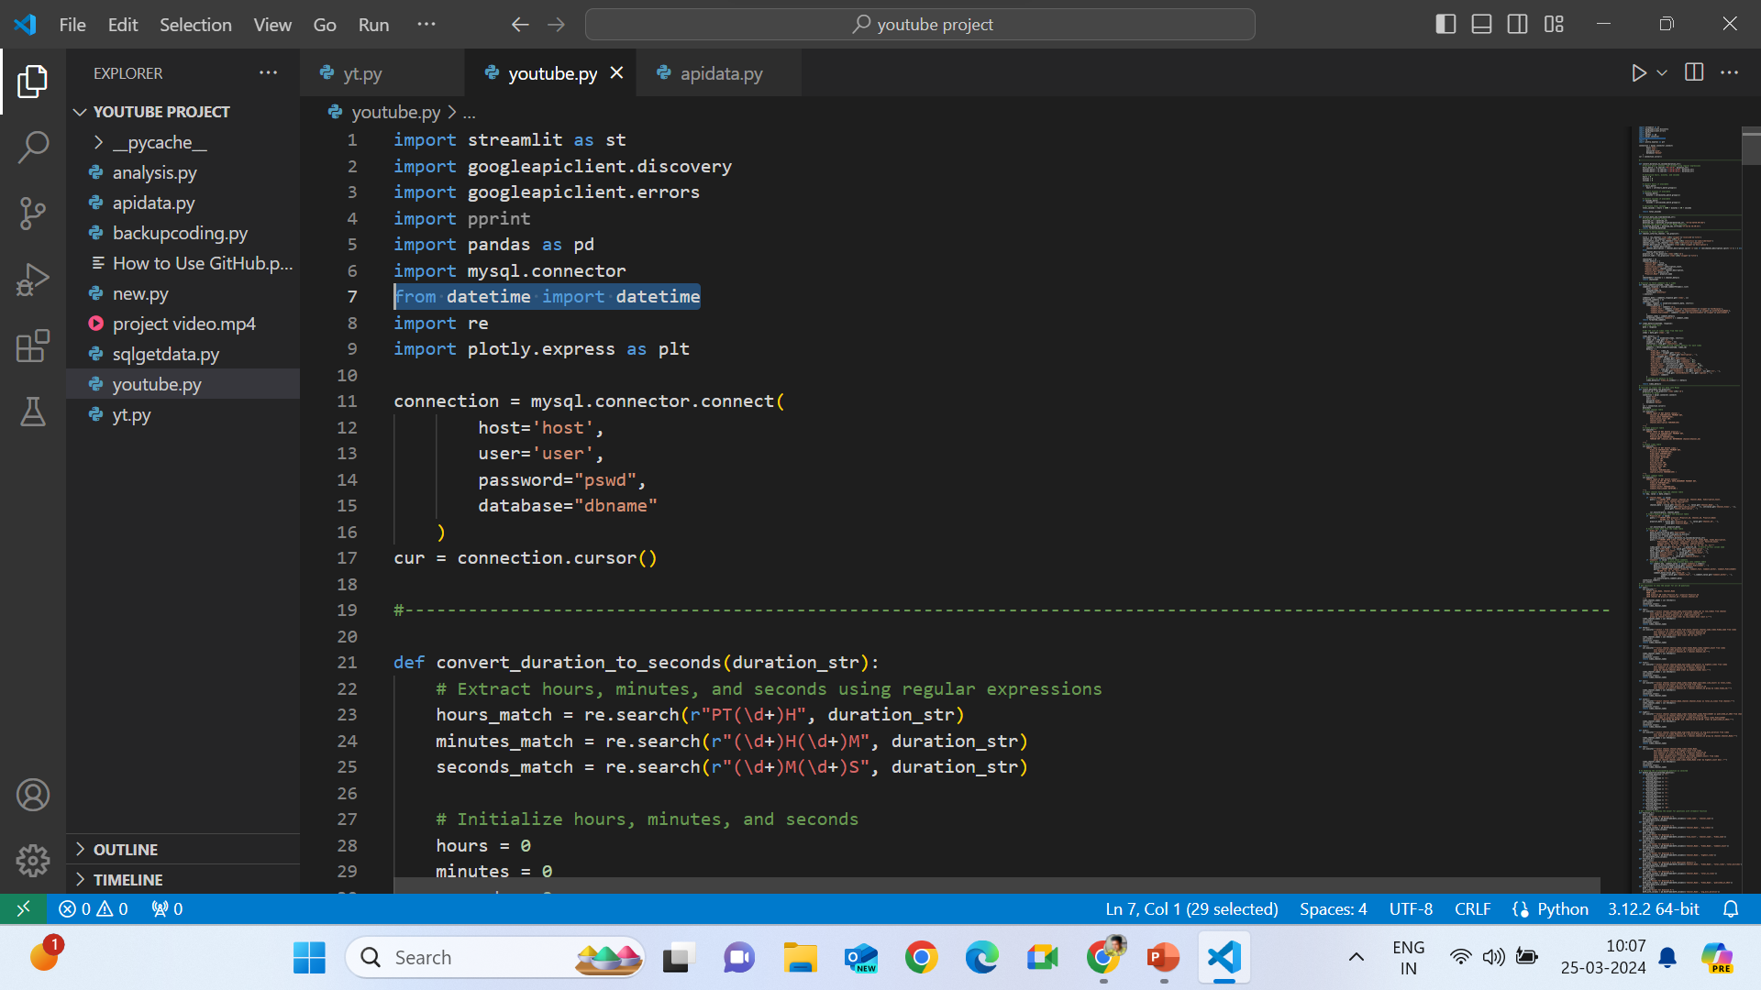

Slide 10
E T L Process
Extract data
Using the YouTube channel id and the YouTube API developer console, get the specific YouTube channel data. Using the playlist id, further video data can also be extracted from a specific channel.

Slide 11
Process and Transform the data:
Takes the necessary information from the extracted data and converts it into a complex JSON format after the extraction process.

Slide 12
Load the data:
Create the required tables and database after the transformation process. then an insert query is used to store that complex JSON data in the MySQL database.
Python can be used in Visual Studio code to execute these ETL processes.

Slide 13
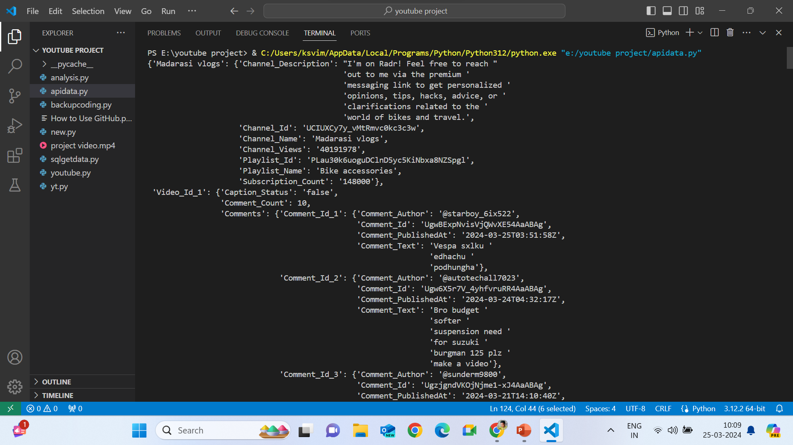
Complex JSON output

Slide 14
E D A Process
Exploratory data analysis (EDA) is used by data scientists to analyze and investigate data sets and summarize their main characteristics, often employing data visualization methods.
Here I done only the sample queries from given problem statement.
To achieve and solve a business problem is the EDA process.

Slide 15
Access MySQL DB
Using the mysql library and access tables, establish a connection to the MySQL server (MySql Workbench) and get access to the specified MySQL DataBase.

Slide 16
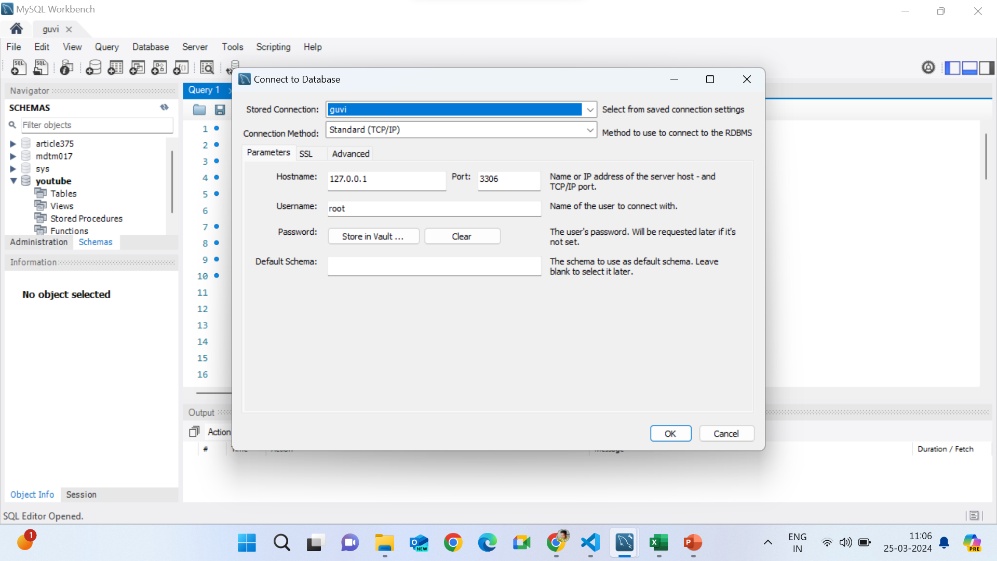
MySql Connection Establishment

Slide 17
FILTER the data
Apply SQL queries to process the information obtained from the tables in accordance with the given questions. Next, create a DataFrame format out of the processed data.

Slide 18
Visualization
Finally, make use of Streamlit to build a dashboard. Provide the user with dropdown options on the dashboard. Next, I was given a task to analyze the data for myself and see the outcomes in a Dataframe Table and a sample scatter-3D image.

Slide 19
User Guide
1. Data collection zone :
Search channel_id, copy and paste on the input box and click the Extract Data to SQL button.
2. Channel Data Analysis zone :
Select a Question from the dropdown option you can get the results in Dataframe format.
3. analysis zone :
By clicking the view analysis button, you can see the scatter-3D chart analysis for the above-mentioned problem.

Slide 20
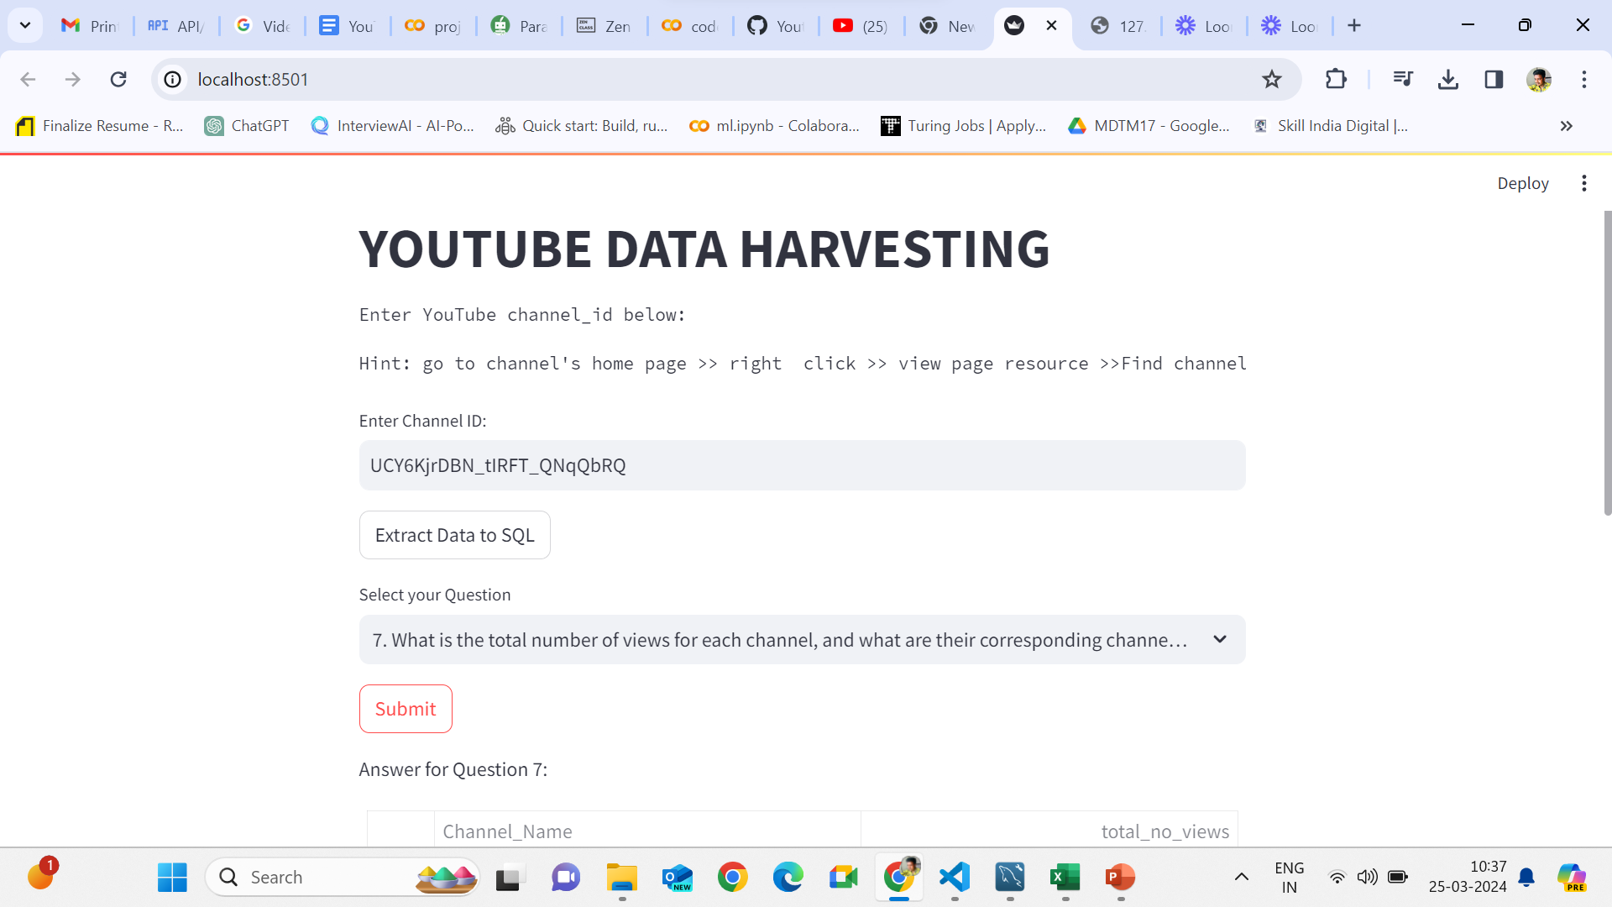
Sample output

Slide 21
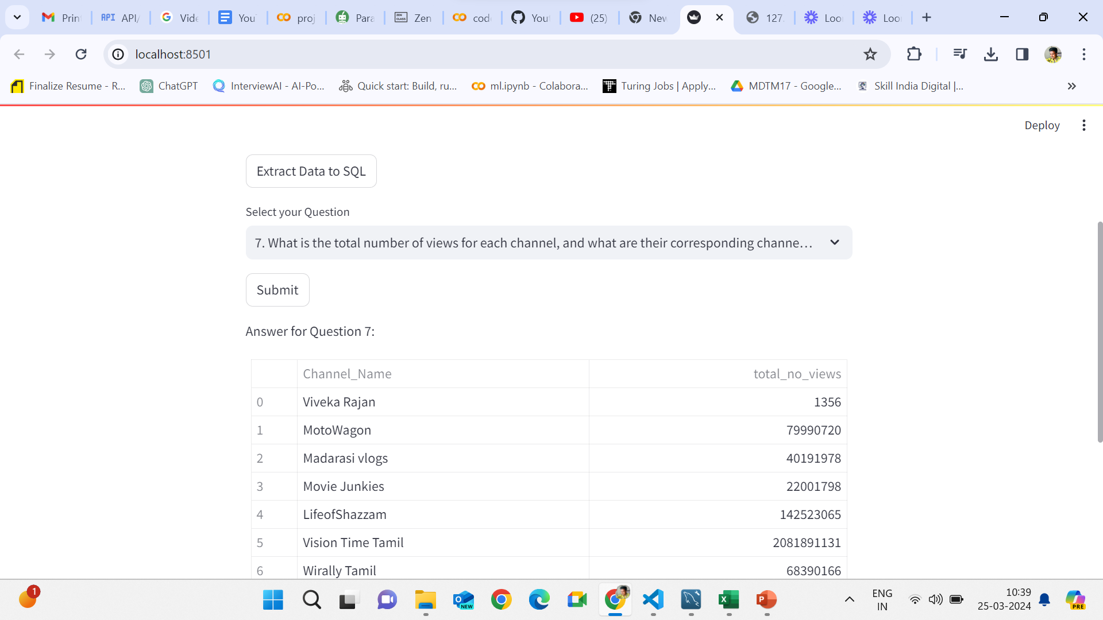

Slide 22
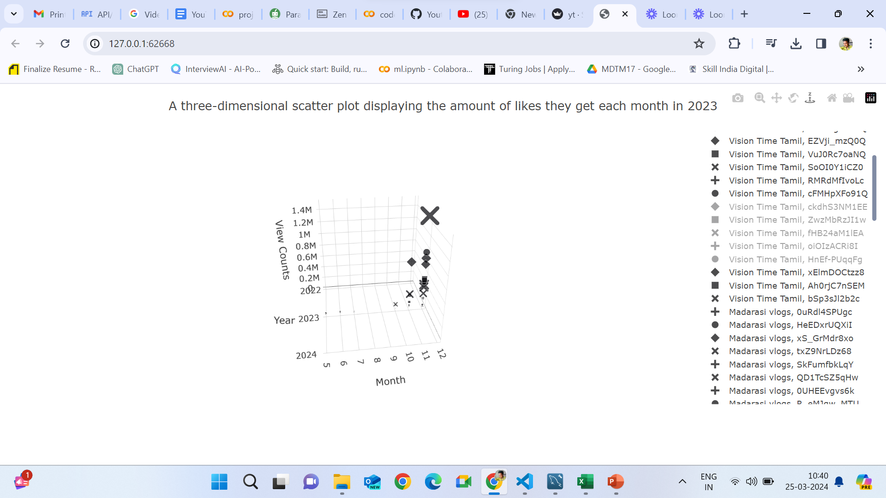
Following the view analysis button click

Slide 23
PROJECT VIDEO
https://www.loom.com/share/bf032619932448d1bbb297230c497484?sid=c0e67819-fb4d-45f3-903c-6883eaddbb9a

Slide 24
THANK YOU !

